Slide 1
Collection Week 4

Slide 2
On Gathering
Why gather
How to gather
Ways to do it

Slide 3
Why Gather?
Notes:
Ask them

Slide 4
Why Gather?
Not being done!
Make the world better
Make something you care about last
Because otherwise someone else will do it instead/in spite of you

Slide 5
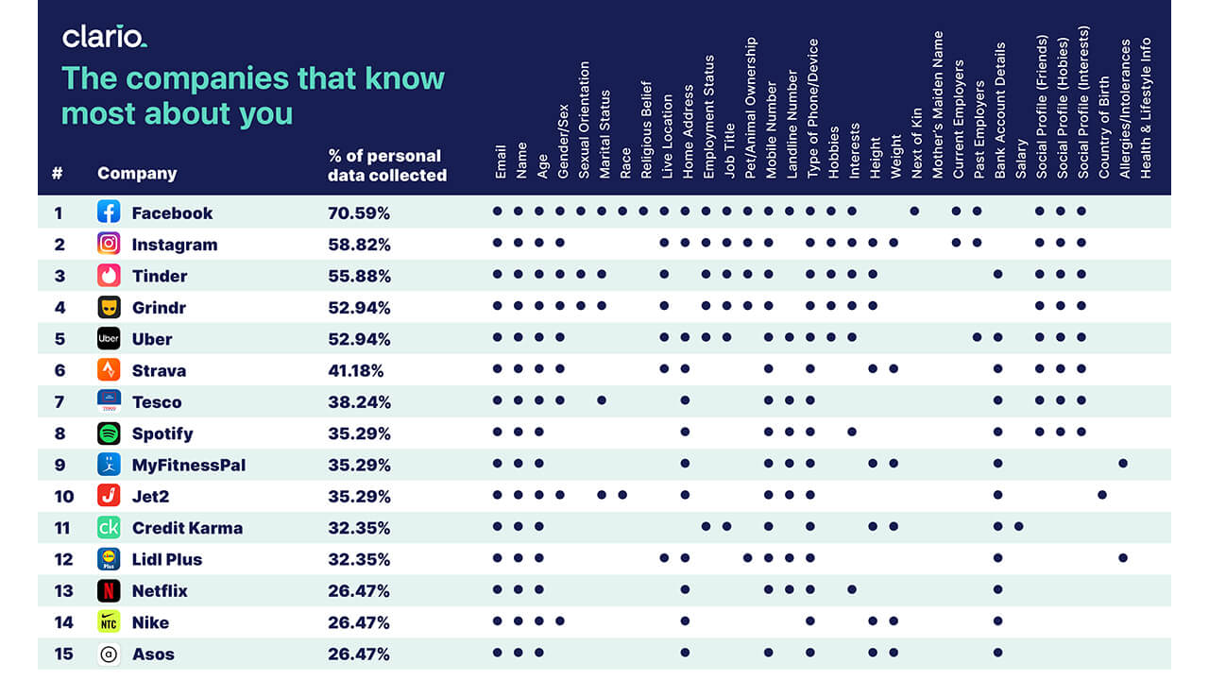
How to Gather – Passively

Slide 6
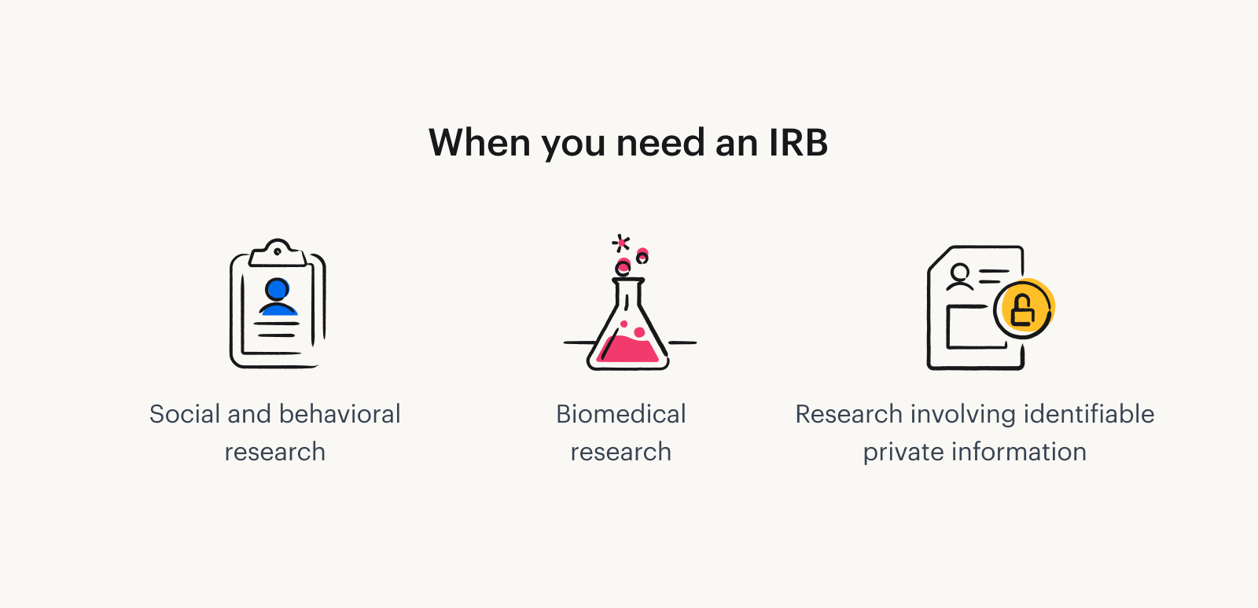

How to Gather - Ethics
Notes:
https://www.tremendous.com/blog/
https://www.google.com/imgres?q=irb&imgurl=https%3A%2F%2Fwww.nsula.edu%2Fwp-content%2Fuploads%2FScreen-Shot-2022-09-01-at-11.16.17-AM.png&imgrefurl=https%3A%2F%2Fwww.nsula.edu%2Fnsu-irb-announces-changes-updates%2F&docid=ktE_eJUmjLq1NM&tbnid=1F-_7zA2Um8I6M&vet=12ahUKEwiMjsD4lKOKAxUYMVkFHWdrBKcQM3oECBgQAA..i&w=4014&h=1688&hcb=2&ved=2ahUKEwiMjsD4lKOKAxUYMVkFHWdrBKcQM3oECBgQAAwhat-is-an-irb-and-what-purpose-does-it-serve/

Slide 7
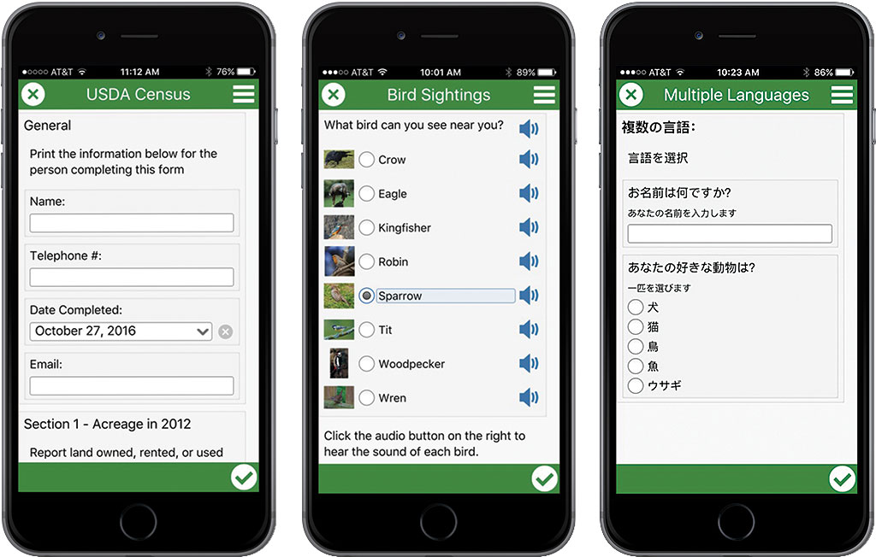
Ways to Gather - Individually
Survey 123 (at right)
Google forms
Can pull directly into spreadsheet
Direct interviews
Best practice is to compensate subjects
Notes:
https://www.esri.com/about/newsroom/arcuser/5-reasons-to-use-survey123-for-arcgis/

Slide 8


Ways to Gather - Crowdsourcing
Notes:
https://www.investopedia.com/terms/c/crowdsourcing.asp

Slide 9
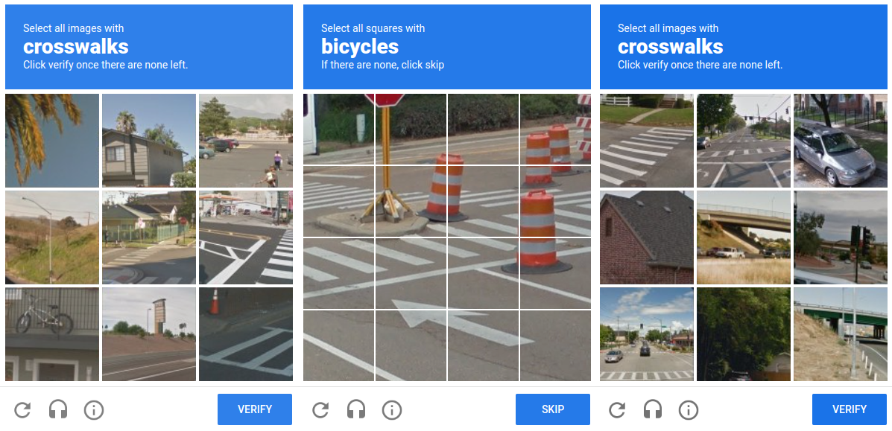
Notes:
What is this? What are you doing when you click it? recaptcha

Slide 10
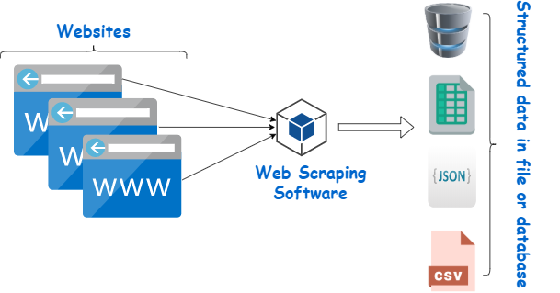
How to Gather – Web Scraping
Notes:
https://www.webharvy.com/articles/what-is-web-scraping.html

Slide 11
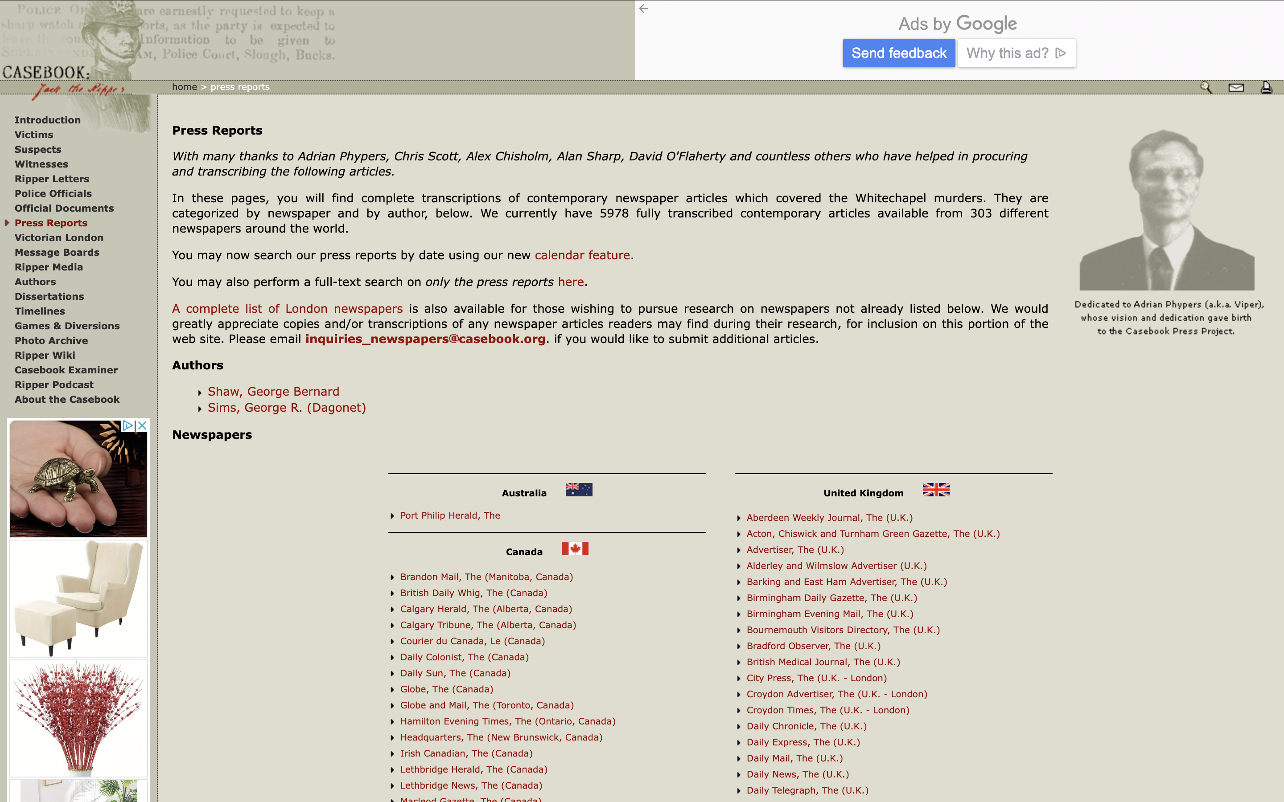
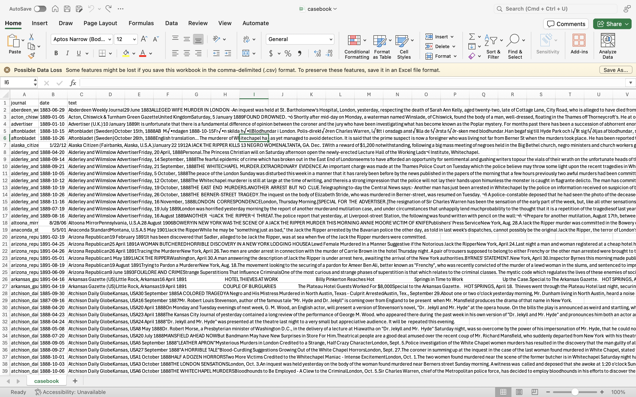
How to Gather – Web Scraping
Notes:
https://www.webharvy.com/articles/what-is-web-scraping.html

Slide 12
How to Scrape - webscraper.io
Options!
Free tools
Speed, scale limitations
Paid Tools
Costs money
Often a lot quicker and more powerful
Custom-built scrapers
Can do just about whatever you want – takes programming exp.
We’re going to use webscraper.io
Freemium
Give you a taste of what and how it works

Slide 13

Has everyone installed?
Notes:
Need to install chrome ahead of time and be using the same browser as well

Slide 14
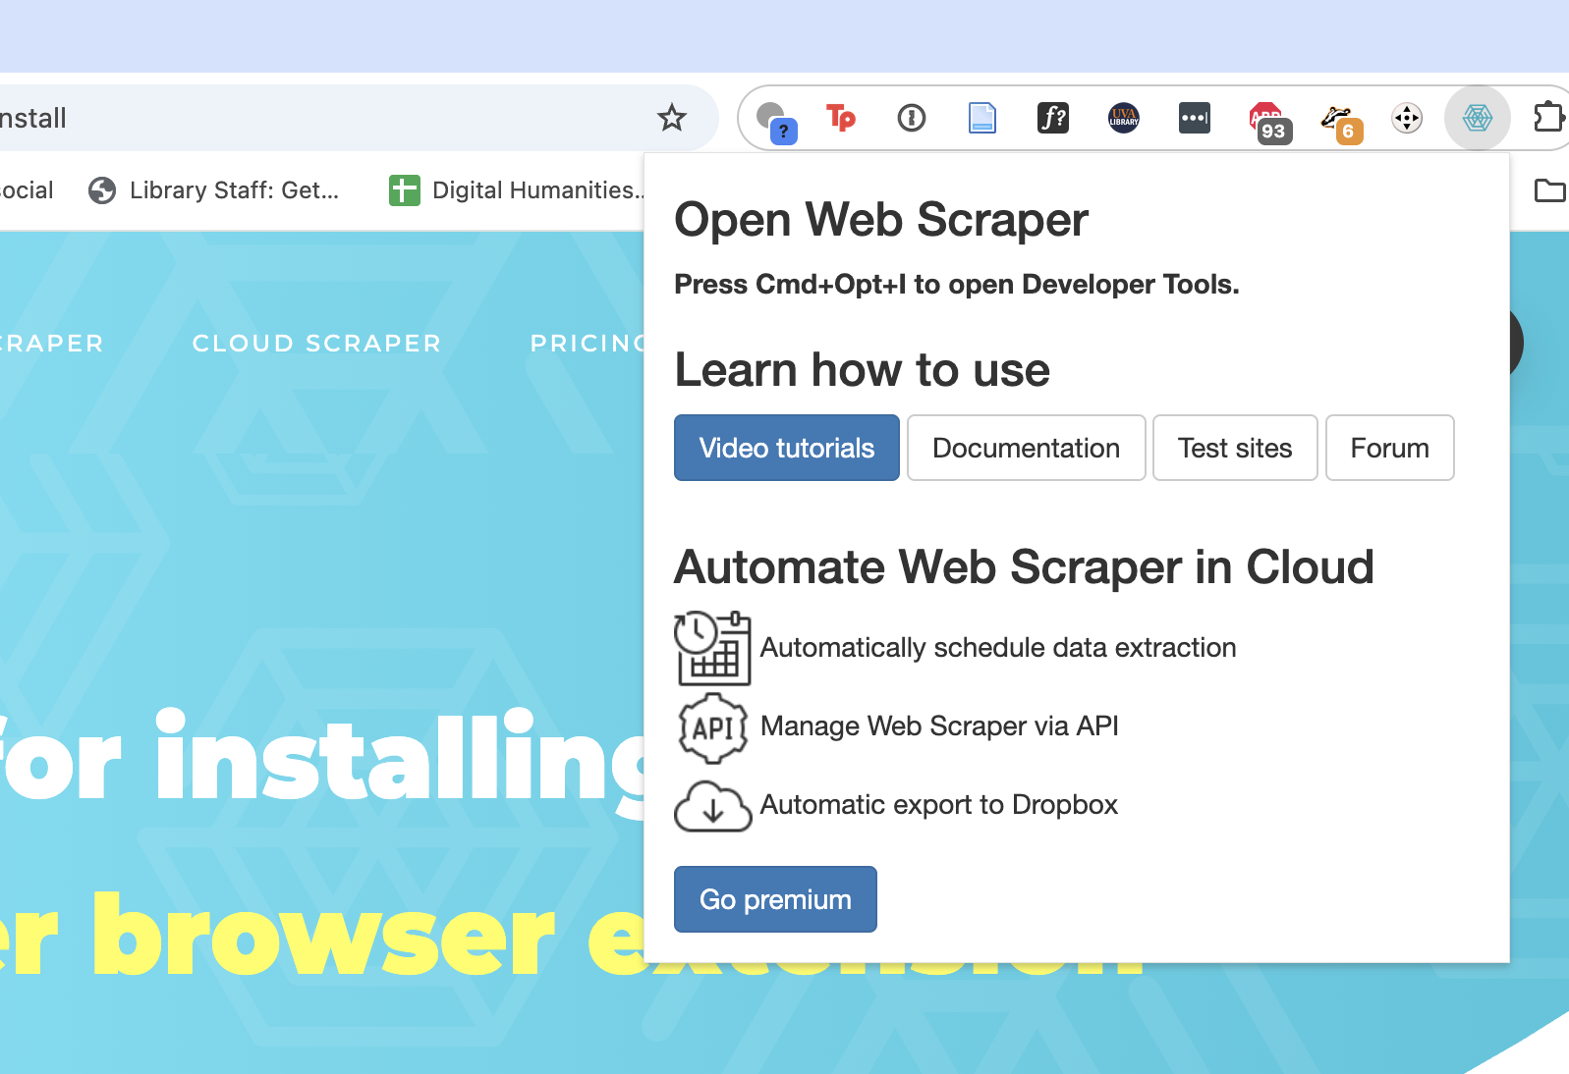
Installation Steps
In chrome go to https://surveys.webscraper.io/
Click “install” then “add to chrome” in the new tab. Then “add extension”
Will either appear in your extensions bar by default or you might have to click on the “extensions” button and pin it
You know you’re good when you see this ->
Notes:
Maybe do screenshots?

Slide 15
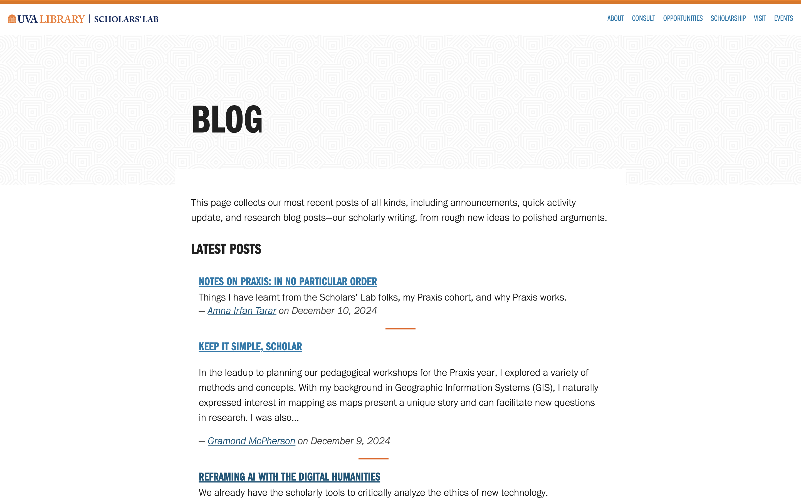
https://scholarslab.lib.virginia.edu/blog/
Notes:
This is what we will be scraping. So go to that page and open the extension

